Slide 1
ESPRESSO AVENUE
Runeesha Senadeera
CB011187

Slide 2
Introduction
Espresso Avenue is a sophisticated mobile application crafted with Flutter, offering a seamless and immersive coffee experience. Navigate through its intuitive interface, whether in light or dark mode, and explore a meticulously curated menu of expertly crafted beverages. The app adapts seamlessly to both portrait and landscape orientations, providing a versatile and user-friendly experience. Espresso Avenue invites users to effortlessly switch between the menu list, notifications, and accounts pages, ensuring a delightful journey through the world of premium coffee, all within the palm of your hand.

Slide 3
Screenshots

Slide 4
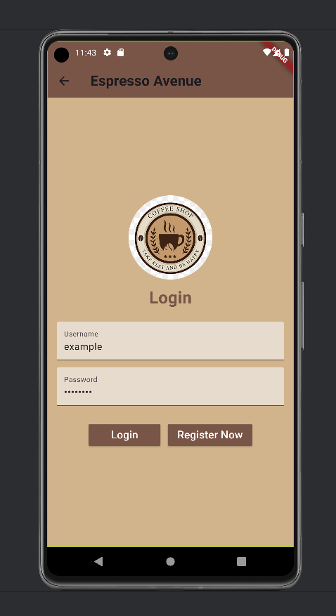
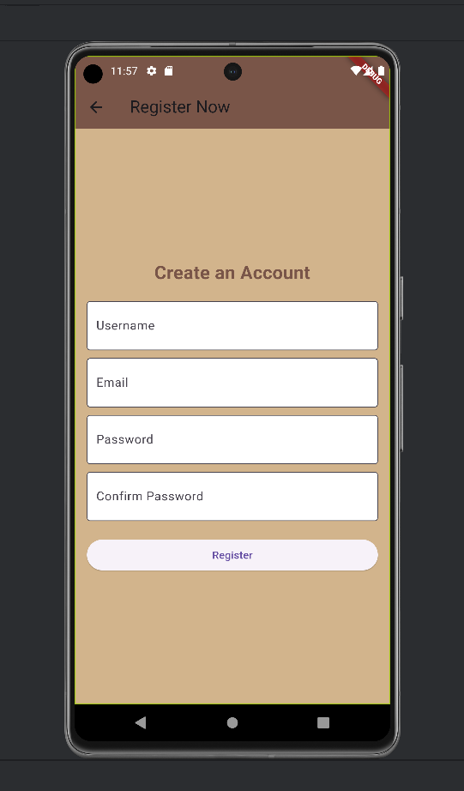
Login and Register Pages

Slide 5
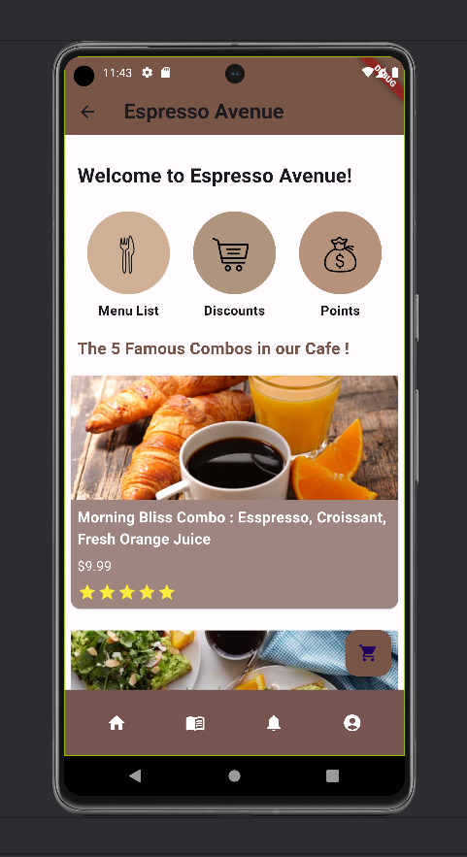
Home Page

Slide 6
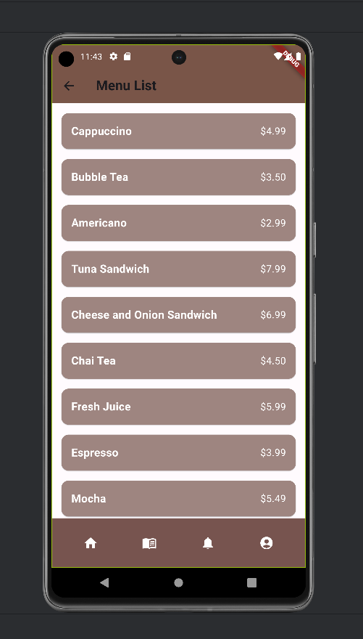
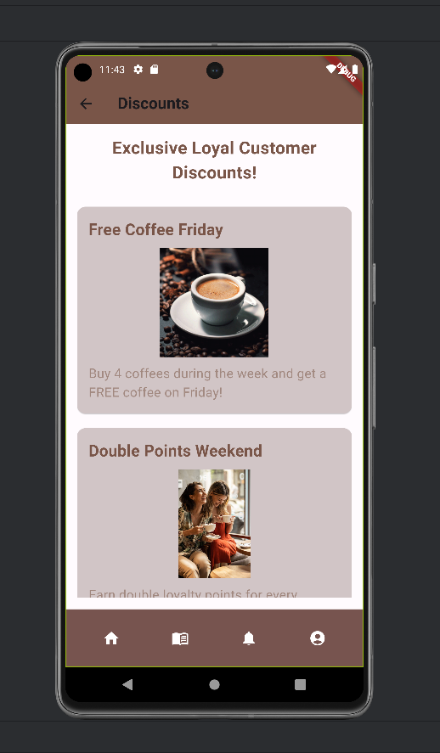
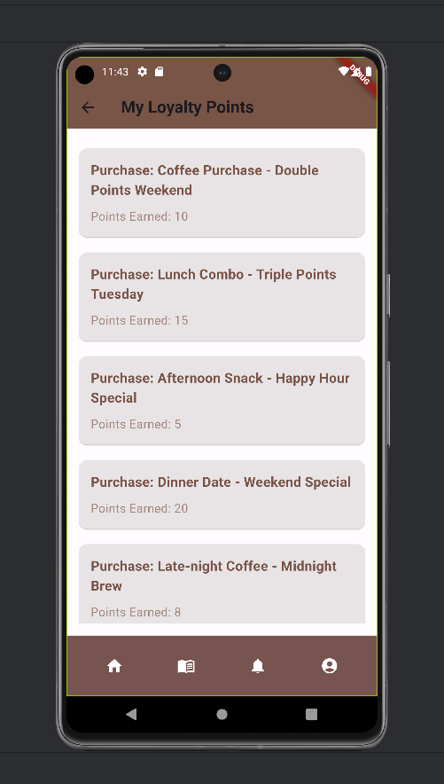
Menu List,Discounts and Points Pages

Slide 7
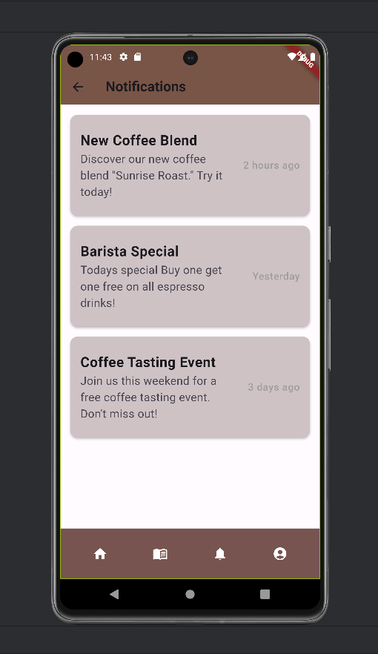
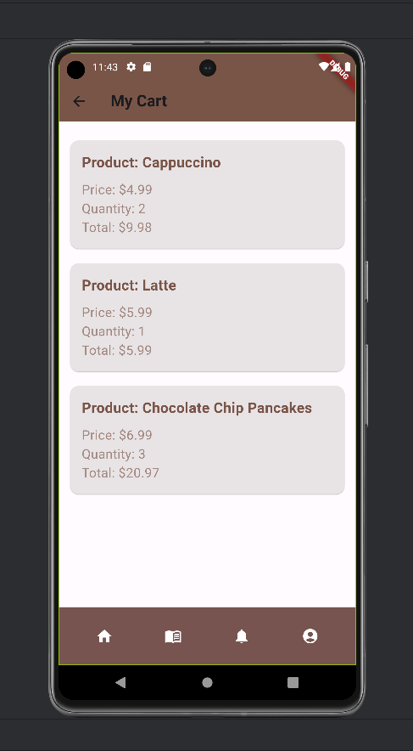
Notification and My Cart Pages

Slide 8
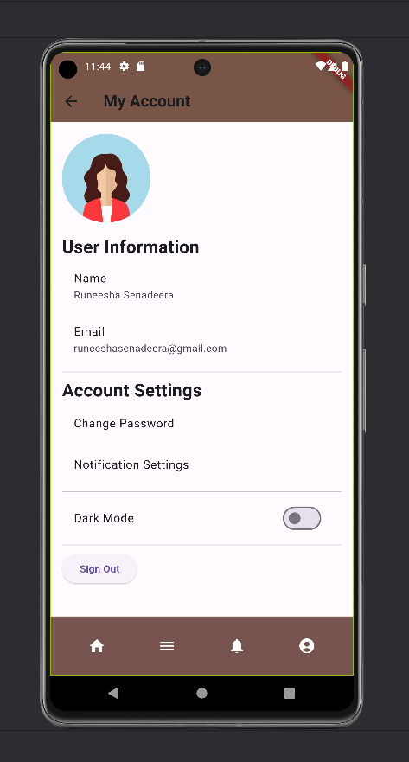
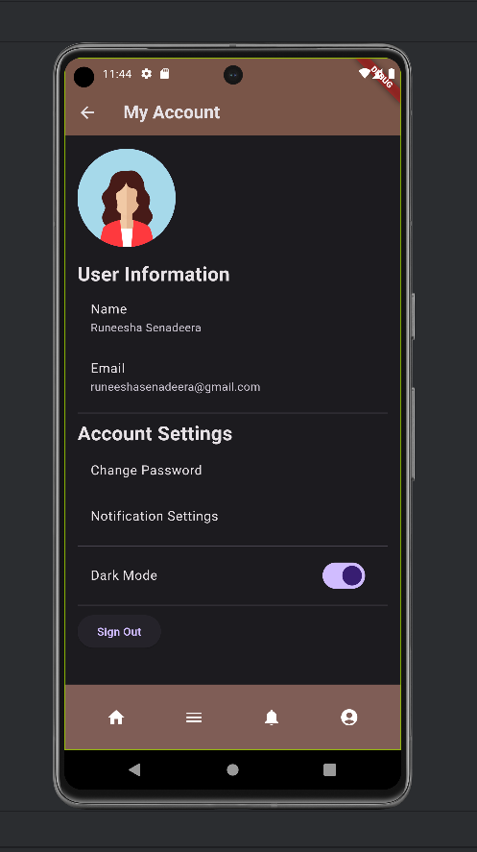
Accounts page – Light and Dark mode

Slide 9
thank you

